Slide 1
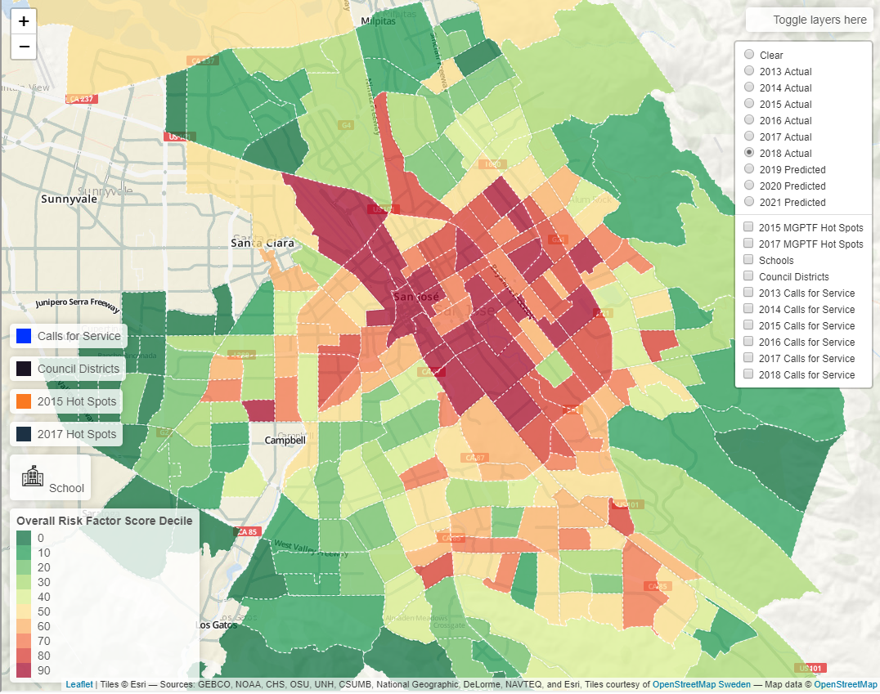
Removes all Risk Factor Layers, makes it easier to see other features such as schools and hotspots.
These are the risk layers. They are the colored tiles (seen on this map) for each neighborhood, which you can click on. They range from green to yellow to red, and show the overall risk factor score for each neighborhood in a given year. Click on these buttons to explore the risk layers for different years. “2013 Actual” to “2018 Actual” use actual data to calculate their risk scores. “2019 Predicted” to “2021 Predicted” are predicted risk scores using machine learning models. Explained more in the “Under the hood document”
Areas in the City determined as hotspots for Gang and Youth Violence by the Mayor’s Gang Prevention Task Force. Shown in black (2017) and orange (2015) outline.
Includes all public Middle and High Schools. Shown as school icons.
Council Districts. Districts are shown in black outline.
High Priority police calls for service. These include calls for violence, major crimes, and other calls for service. Shown by neighborhood (same as risk layers). Shown as blue circles.

